Slide 1

Richard J. Ornstein Attorney
Hon. Rick Stiltner
Sr. Relationship Officer
Road Salt Procurement
March 24, 2026

Slide 2

State Price Contract
KRS 45A.050
Is salt listed?
Is the price competitive?
No advertising requirement

Slide 3
Cooperative Purchasing
KRS 45A.295& 45A.300
What is cooperative purchasing?
Is salt listed?
Is the price competitive?
Are you a member?

Slide 4
Interlocal Cooperation Agreement
KRS 65.210-65.300
Are any local governments interested?
Who takes the lead/contracting agency?
Model Procurement Code (MPC) (KRS 45A.343-460)—online advertising
Non-MPC counties (KRS 424.260)—newspaper advertising
Create an agreement for DLG approval
Issue an RFP—Sealed bid
Price only or Price+—delivery, storage, qualifications…
Bidder qualifications—past performance, timeliness…
Evaluate the bid

Slide 5
Sealed Bid — Advertisement
Model Procurement Code or KRS 424.260
Advertise—MPC
Online or qualified newspaper
At least 7 days prior to bid opening
Share the advertisement with known providers
Advertise—KRS 424.260
Qualified newspaper
Not less than 7 days nor more than 21 days from bid due date

Slide 6
Sealed Bid — Advertisement
Model Procurement Code or KRS 424.260
Mandatory Content
Due date/location
Time/place of bid opening
Tonnage
Contact/additional information
Discretionary Content
Evaluation factors:
Price
Delivery
Storage
Quality
Bidder qualification examples:
Past performance
Timeliness
Electronic bids

Slide 7
Sealed Bid — Receipt
Model Procurement Code or KRS 424.260
Bid receipt
In-person
Mail/commercial delivery
Electronically
Subject line example: ‘Sealed Bid—Salt’

Slide 8
Sealed Bid — Public Bid Opening
Model Procurement Code or KRS 424.260
Judge/executive or designee
Advertised time and location
Witnesses
Create record

Slide 9
Sealed Bid — Bid Evaluation
Model Procurement Code or KRS 424.260
Lowest or Best Bidder
Evaluated bid--written determination
Factor weight
Initial evaluation/recommendation
CJE
Committee
Other

Slide 10
Sealed Bid — Fiscal Court Approval/Contract
Model Procurement Code or KRS 424.260
Fiscal court approval required
Present recommendation
Fiscal court chooses lowest bid or best bid
Does not have to choose the recommendation
County attorney
Opportunity to review all submissions pre-approval
Contract review
Contract approval
CJE execution

Slide 11
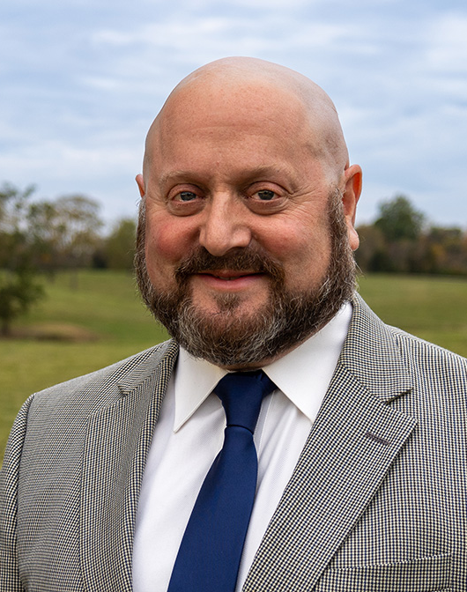

Rich Ornstein
Staff Attorney
rich.Ornstein@kaco.org
Rick Stiltner
Senior Relationship Officer
rick.stiltner@kaco.org

