Slide 1

Reporting and Budgeting for Local Opioid Settlement Funds
March 4, 2026

Slide 2

Jessie Halladay, Deputy Executive Director Jessica Stines, Executive Advisor – Accountability and Advancement
Kentucky Office of the Attorney General

Slide 3


































Why Compliance Matters
Public transparency
Dashboard
Open records requests
Long-term evaluation of funds

Slide 4
FY 2025 Numbers
Total Amount Received by All Local Governments: $123.5M
Expenditures by Counties in FY 2025: $12.6M
Remaining Funds for Counties as of June 30, 2025: $86.6M

Slide 5
What Must Be Reported
General Information
Fiscal year
Local government demographic information Designated reporter confirmation
Local governments submit details on financial and program impact regarding opioid settlement funds disbursed in the fiscal year.
The report is found on the KYOAAC Website. It stays open year-round. Reports are due August 31 every year.
Login credentials may be obtained from the Commission staff.
Financial Reporting
Amount Received to Date Beginning Balance Amount Received in the FY Interest
Expenditures Ending Balance

Slide 6


Progress & Impact Reports
Progress Information
Contact Information Amount Dispersed Purpose of Funding
Did you spend or disperse funding?
A recipient is any
entity funds other
that
receives
opioid settlement project, staff, or
to pay
for a
purpose. This
Impact Reporting
includes any branch or department of
the local government that received
Project Description Progress Description Significant Outcomes Implementation Stage
Treatment/Recovery/Prevention Statistics Other strategies descriptions
funds from the settlement distributor. It also includes any external entity, such as a community non-profit, corporation, or other partnership.

Slide 7



























2026 Timeline
March 2026
June 2026
August 2026
Survey
Reminder to update designated reporters
FY closes June 30 Ongoing training
Reports due August 31
May 2026
Reminder of upcoming deadlines
Ongoing training
July 2026
Reporting Portal opens July 1, 2026
Dashboard goes live
September/October 2026
Review of reports and follow up as needed.

Slide 8
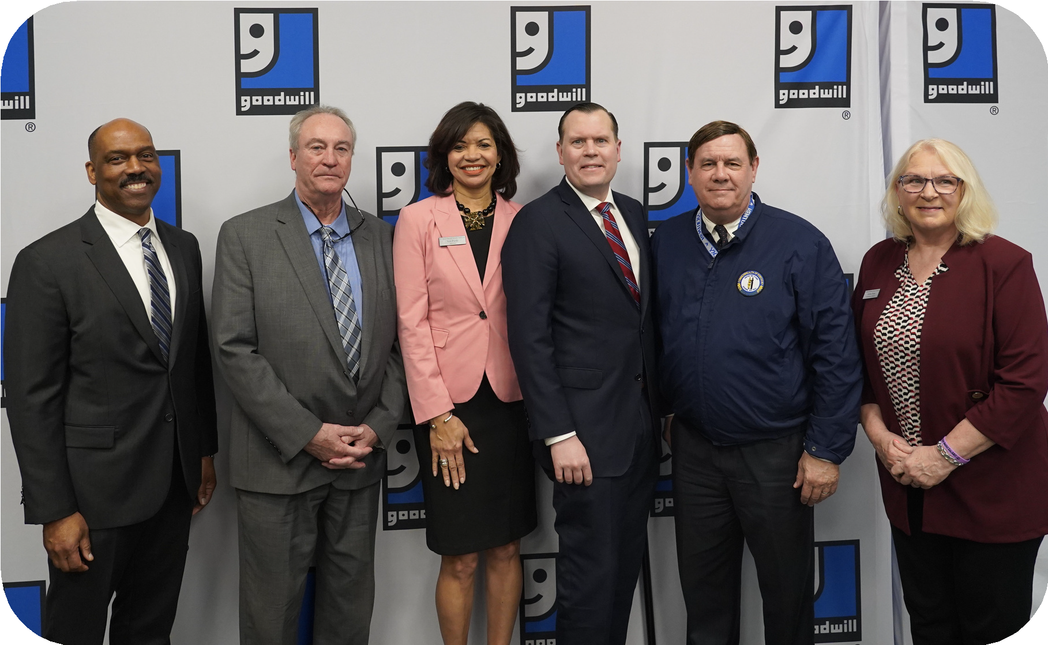























































Questions & Feedback
Phone
502-696-5393
Email
kyoaacreporting@ky.gov
Website
kyoaac.ky.gov

Slide 9
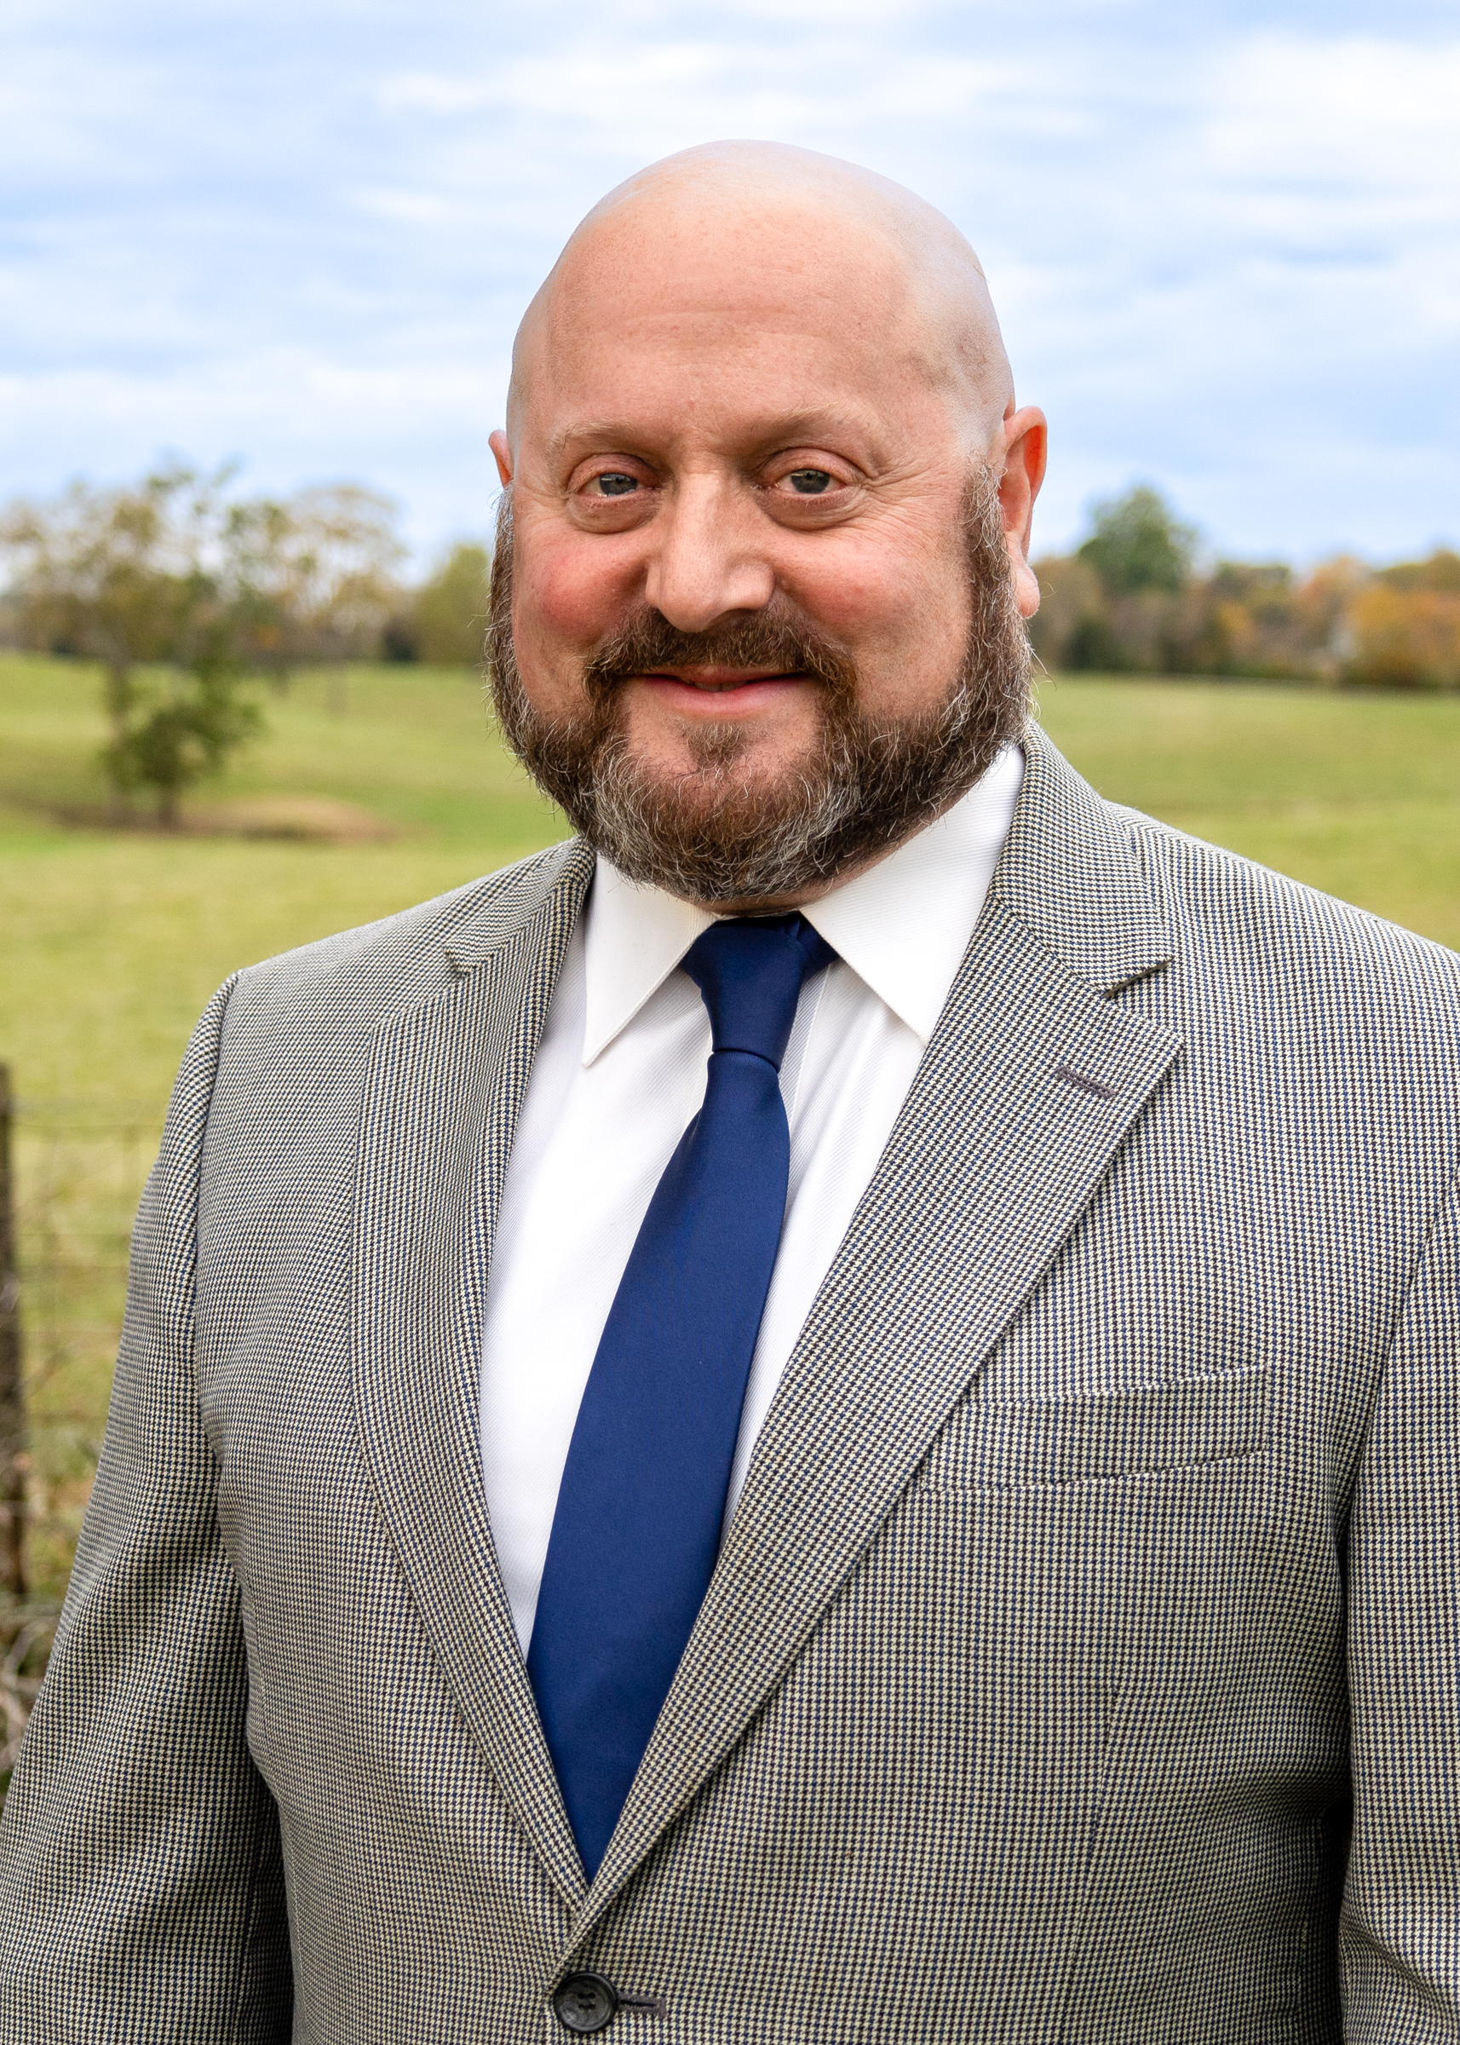
Opioid Budgeting
DLG code: 74
MOUs/Contract
Budgeting basics
Tell your story

Slide 10
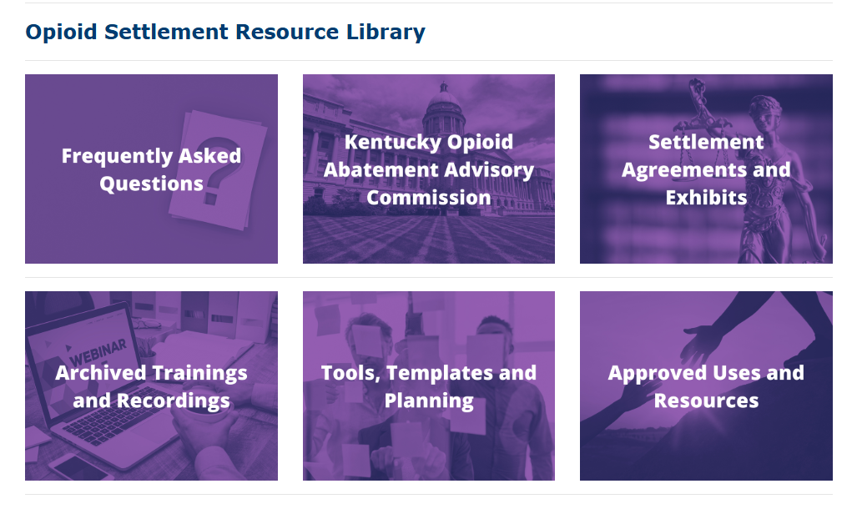
KACo Opioid Settlement Resource Library

Slide 11
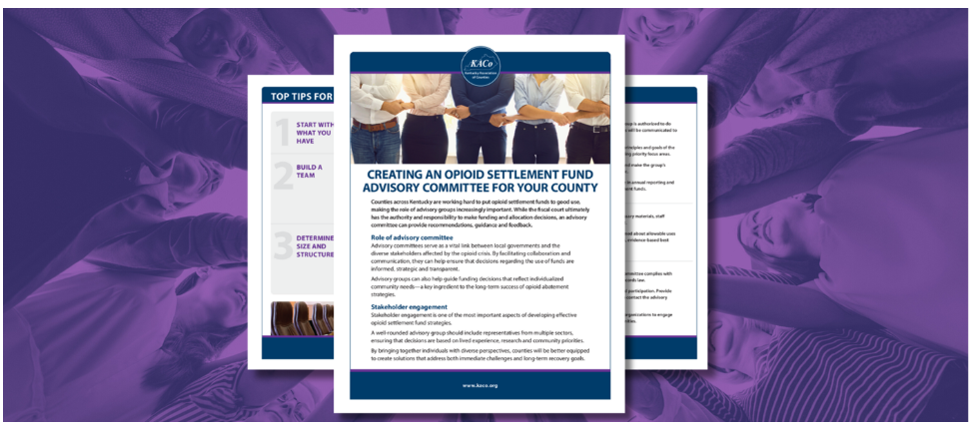
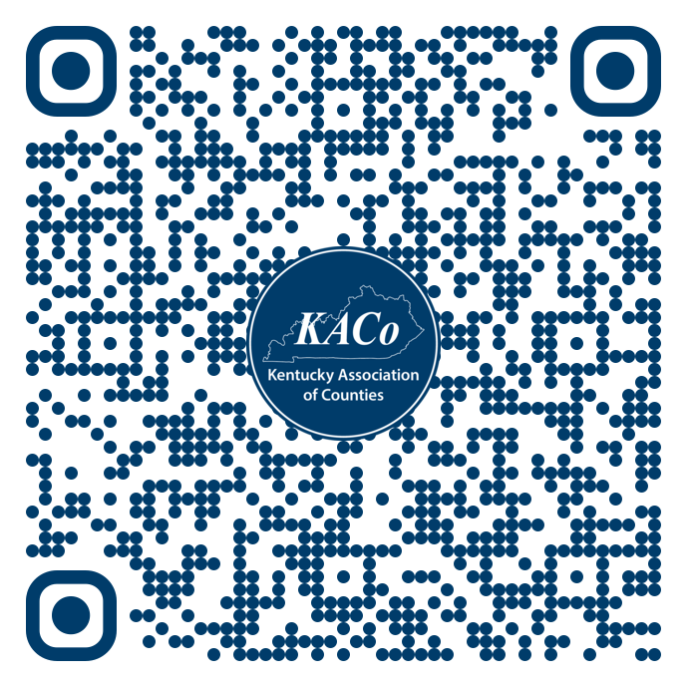
KACo Opioid Solutions Learning Opportunities
Check out KACo’s resource library for continuing education opportunities highlighting how counties are using their opioid settlement funds in innovative, effective, and sustainable ways. You’ll find best practices on topics such as youth prevention, peer support, access to treatment, quick response teams, and more. Stay tuned for new resources and updates!

Slide 12

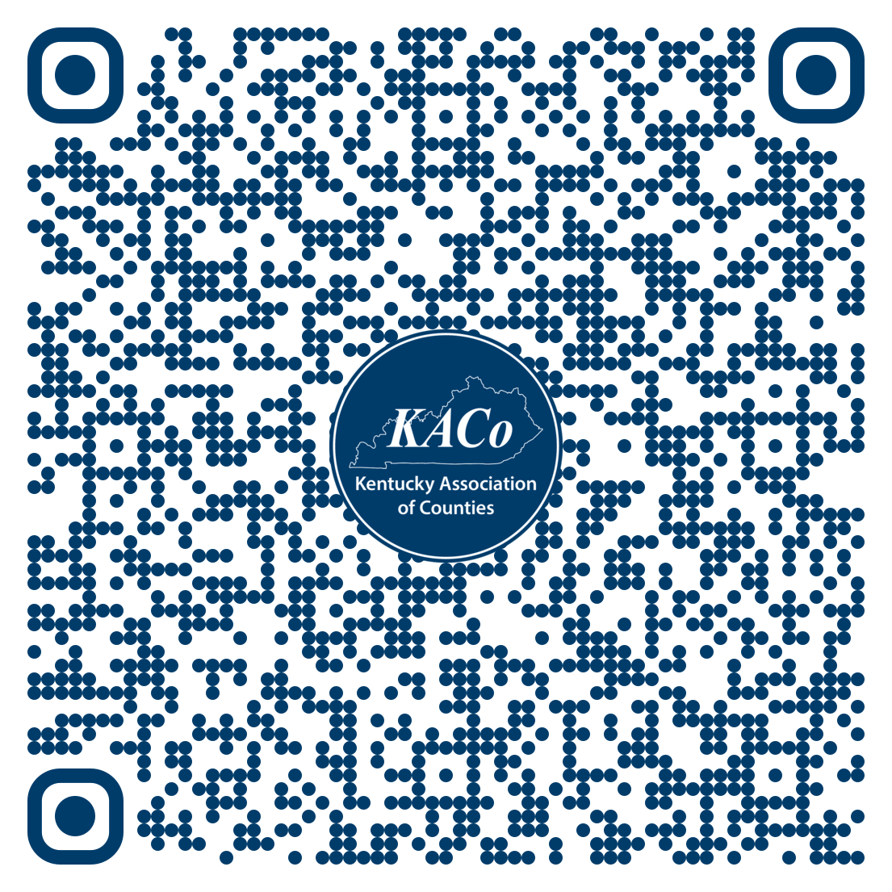

Slide 13

Opioid Settlement Advisor
Guidance on opioid settlement use
Review of allowable expenses
Support for long-term and strategic planning
Access to templates and standardized forms
Assistance with mandatory reporting requirements
Review of best practices and peer examples
Training and education opportunities
Referrals to qualified practitioners and subject-matter experts
Lauren Carr
lauren.carr@kaco.org

